Slide 1
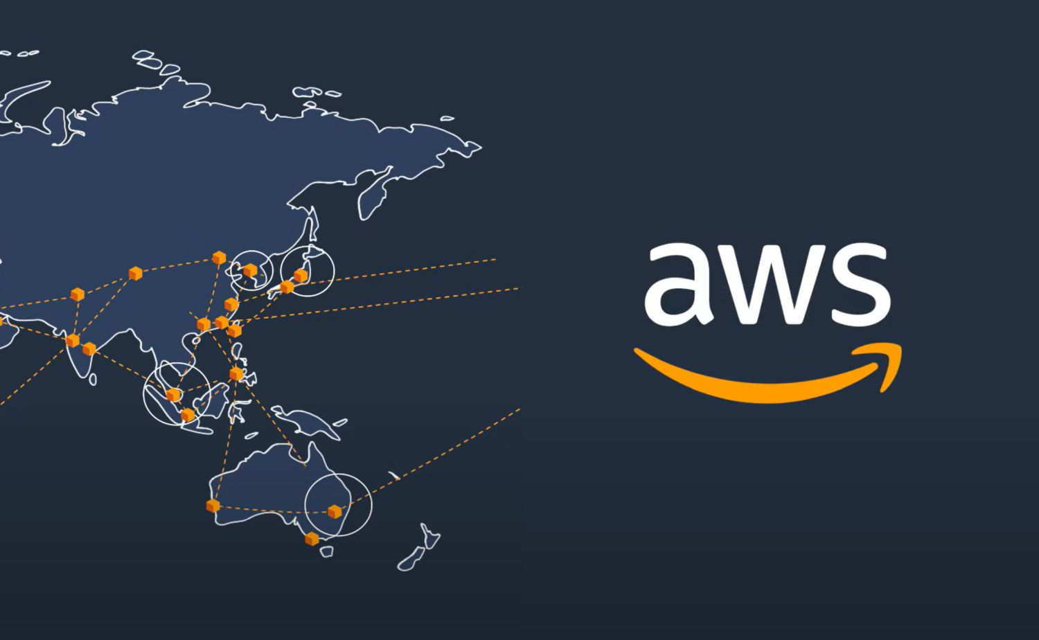

Introduction to AWS Inspector

Slide 2
What is AWS Inspector?
AWS Inspector is an automated security assessment service that helps improve the security and compliance of applications deployed on AWS.
It automatically assesses applications for vulnerabilities, deviations from best practices, and potential security threats, providing actionable findings to help improve security posture.

Slide 3
Key Features of AWS Inspector
Automated Security Assessments:
AWS Inspector performs automated security assessments on AWS resources, such as EC2 instances, containers, and networks. It checks for vulnerabilities, insecure configurations, and compliance with security standards.
Rich Set of Rules Packages:
AWS Inspector uses pre-built rules packages to assess resources against various security benchmarks, such as Center for Internet Security (CIS) benchmarks, Common Vulnerabilities and Exposures (CVE) databases, and custom security policies.

Slide 4
Continuous Monitoring:
AWS Inspector continuously monitors your environment, identifying new vulnerabilities and threats as they emerge. This ongoing assessment helps maintain a strong security posture over time.
Actionable Findings:
The service generates detailed findings that include descriptions of the issues, severity levels, and recommended remediation steps. These findings help prioritize and address vulnerabilities effectively.
Integration with AWS Security Services:
AWS Inspector integrates with other AWS security services, such as AWS Security Hub, Amazon GuardDuty, and AWS Config, providing a comprehensive security framework. It can also be integrated with third-party tools for enhanced threat detection and response.

Slide 5
Benefits of AWS Inspector
Improved Security Posture:
AWS Inspector helps identify and remediate vulnerabilities in your AWS environment, ensuring that applications and workloads are secure and compliant with industry standards.
Simplified Compliance:
By continuously assessing your resources against industry standards and regulatory requirements, AWS Inspector helps organizations meet compliance obligations more easily.

Slide 6
Reduced Risk:
Proactively identifying and addressing security vulnerabilities reduces the risk of data breaches, unauthorized access, and other security incidents.
Automated and Scalable Assessments:
AWS Inspector’s automated assessments can be scaled across large environments, making it easier to maintain security across multiple instances, containers, and networks.

Slide 7
How AWS Inspector Works
Assessment Targets:
Users define assessment targets, which specify the resources to be assessed, such as EC2 instances, Auto Scaling groups, or specific tags. This allows for targeted assessments based on specific security needs.
Assessment Templates:
AWS Inspector uses assessment templates that define the rules packages, duration, and other settings for the assessment. Templates can be customized to focus on specific security concerns, such as network security or operating system vulnerabilities.

Slide 8
Running Assessments:
Once the assessment template is defined, users can initiate assessments manually or automate them through scheduling. AWS Inspector then scans the specified resources, checking for vulnerabilities, misconfigurations, and compliance issues.
Generating Findings:
After the assessment is complete, AWS Inspector generates a detailed report of findings. This report includes information on each identified issue, its severity, and recommended remediation steps.
Remediation:
Findings from AWS Inspector should be prioritized and addressed based on their severity and impact. Users can take remedial actions, such as patching vulnerabilities, correcting configurations, or implementing security best practices.

Slide 9
Security and Best Practices
Least Privilege Principle:
Ensure that AWS Inspector has only the necessary permissions to perform assessments, adhering to the principle of least privilege.
Regular Assessments:
Schedule regular assessments to maintain continuous visibility into the security posture of your AWS resources.

Slide 10
Integration with Security Operations:
Integrate AWS Inspector findings into your broader security operations and incident response plans to ensure timely and effective remediation.
Compliance and Reporting:
Use AWS Inspector reports to demonstrate compliance with security policies and regulatory requirements during audits and assessments.

Slide 11
Why Use AWS Inspector?
AWS Inspector is an essential tool for organizations looking to enhance the security of their AWS environments. By automating the assessment of resources and providing actionable insights, it helps maintain a strong security posture, reduce risk, and simplify compliance with industry standards.

